Slide 1
IoT Security and Privacy
IoT communication protocols
Xinwen Fu

Slide 2
Learning Outcomes
Upon completion of this unit:
Student will master the HTTP protocol
Students will master the HTTPS protocol
Students will understand webscokets
Students will understand MQTT

Slide 3
Outline
http
https
Websockets
MQTT

Slide 4
HyperText Transfer Protocol (HTTP)
HTTP, communication protocol between a client (browser) and a web server
Client and server establish TCP connection
Client requests content
Server responds with requested content
Client and server close connection
HTTP history
Initiated by Tim Berners-Lee at CERN in 1989
Standardized by IETF and W3C, the first definition of HTTP/1.1 in 1997, 1999 and 2014
Standardized HTTP/2 in 2015
HTTP request
Web
client
(browser)
Web
server
HTTP response
(content)

Slide 5
HTTP messages
HTTP is the language between web clients and web servers
Each message has three parts
A client request message has components in the following order
Request line
Header section
Message body
A server response message has components in the following order
Response line
Header section
Message body

Slide 6
Anatomy of an HTTP Transaction
unix> telnet www.aol.com 80
Trying 205.188.146.23...
Connected to aol.com.
Escape character is '^]'.
GET / HTTP/1.1
host: www.aol.com
HTTP/1.0 200 OK
MIME-Version: 1.0
Date: Mon, 08 Jan 2001 04:59:42 GMT
Server: NaviServer/2.0 AOLserver/2.3.3
Content-Type: text/html
Content-Length: 42092
<html>
...
</html>
Connection closed by foreign host.
unix>
Client: open connection to server
Telnet prints 3 lines to the terminal
Client: request line
Client: required HTTP/1.1 HOST header
Client: empty line terminates headers.
Server: response line
Server: followed by five response headers
Server: expect HTML in the response body
Server: expect 42,092 bytes in the resp body
Server: empty line (“\r\n”) terminates headers
Server: first HTML line in response body
Server: lines of HTML not shown.
Server: last HTML line in response body
Client: closes connection and terminates

Slide 7
Make http request through netcat (nc)
$ nc www.rssweather.com 80 GET /wx/in/kanpur/wx.php HTTP/1.0 Host: www.rssweather.com
Copy paste the get request and header
And then hit double <enter>
Notes:
https://stackoverflow.com/questions/32341518/how-to-make-an-http-get-request-manually-with-netcat

Slide 8
Client – Request line
Client sends a request message to server at a port, 80 by default
The first part of the message is the request line, containing:
A method (HTTP command) such as GET or POST GET – request data from a specified resource POST – submit data for processing to a specified resource
A document address, and
An HTTP version number
Example:
GET /index.html HTTP/1.0

Slide 9
Other methods
Other methods beside GET and POST are:
HEAD: Like GET, but ask that only a header be returned
PUT: Request to store the entity-body at the URI
DELETE: Request removal of data at the URI
LINK: Request header information to be associated with a document on the server
UNLINK: Request to undo a LINK request
OPTIONS: Request information about communications options on the server
TRACE: Request that the entity-body be returned as received (used for debugging)

Slide 10
Client – Header information
The second part of a request is optional header information, notifying the server:
Client software
Acceptable data/file formats
All information is in the form of Name: Value
Example:
User-Agent: Mozilla/2.02Gold (WinNT; I) Accept: image/gif, image/jpeg, */*
A blank line ends the header

Slide 11
Client request headers
Accept: type/subtype, type/subtype, ...
Specifies media types that the client prefers to accept
Accept-Language: en, fr, de
Preferred language (For example: English, French, German)
User-Agent: string
The browser or other client program sending the request
From: dave@acm.org
Email address of user of client program
Cookie: name=value
Information about a cookie for that URL
Multiple cookies can be separated by commas

Slide 12
Client – Entity body
The third part of a request (after the blank line) is the entity-body for optional data
Used mostly by POST requests
Always empty for a GET request

Slide 13
Server – Status line
The first part is the status line, including:
The HTTP version
A status code
A short description of what the status code means
Example: HTTP/1.1 404 Not Found
Status codes are in groups:
100-199 Informational
200-299 The request was successful
300-399 The request was redirected
400-499 The request failed
500-599 A server error occurred

Slide 14
Common status codes
200 OK
Everything worked, here’s the data
301 Moved Permanently
URI was moved, but here’s the new address for your records
302 Moved temporarily
URL temporarily out of service, keep the old one but use this one for now
400 Bad Request
There is a syntax error in your request
403 Forbidden
You can’t do this, and we won’t tell you why
404 Not Found
No such document
408 Request Time-out, 504 Gateway Time-out
Request took too long to fulfill for some reason

Slide 15
Server – Header information
The second part of the response is header information, ended by a blank line
Example:
Server: Apache
Last-Modified: Tue, 20 Mar 2018 15:36:52 GMT
ETag: "1d6ef3d29e3b6654c7c8e7de310a062c"
Access-Control-Allow-Origin: *
Link: <https://www.ucf.edu/alert/wp-json/>; rel="https://api.w.org/"
Vary: Accept-Encoding
Content-Encoding: gzip
X-Apache-Server: SMCAWEB1
Content-Type: text/xml; charset=UTF-8
Content-Length: 467
Accept-Ranges: bytes
Date: Fri, 06 Apr 2018 15:14:44 GMT
X-Varnish: 1230425297 1230350034
Age: 2035
Via: 1.1 varnish
Connection: keep-alive
X-Cache: HIT
X-Varnish-Server: SMCACACHE2

Slide 16
Viewing the response
Live HTTP Headers for Firefox
An example HTTP/1.1 200 OK Date: Wed, 10 Sep 2003 00:26:53 GMT Server: Apache/1.3.26 (Unix) PHP/4.2.2 mod_perl/1.27 mod_ssl/2.8.10 OpenSSL/0.9.6e Last-Modified: Tue, 09 Sep 2003 19:24:50 GMT ETag: "1c1ad5-1654-3f5e2902” Accept-Ranges: bytes Content-Length: 5716 Keep-Alive: timeout=15, max=100 Connection: Keep-Alive Content-Type: text/html
Status line
Response headers

Slide 17
Server response headers
Server: NCSA/1.3
Name and version of the server
Content-Type: type/subtype
Should be of a type and subtype specified by the client’s Accept header
Set-Cookie: name=value; options
Requests the client to store a cookie with the given name and value

Slide 18
Server – Entity body
The third part of a server response is the entity body
This is often an HTML page
But it can also be a jpeg, a gif, plain text, etc.-- anything the browser (or other client) is prepared to accept

Slide 19
HTTP Summary
Client (browser) requests documents/files from server using the HTTP protocol
Browser then displays the documents (HTMLs/images/…)
Users of the browser do not see the underlying HTTP message exchanges
Only see the results

Slide 20
Http hacking tools
Burp - intercept, view, and modify HTTP requests and responses.
First, download and run Burp locally
Configure a few settings to ensure our browser uses Burp

Slide 21
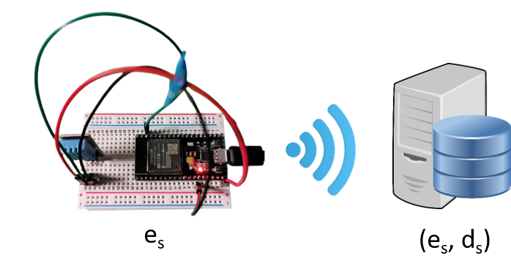
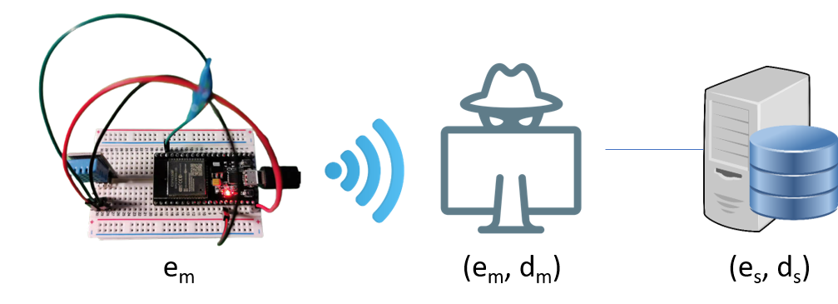
mitmproxy
An open course interactive HTTPS proxy
Interactive: can manipulate the ongoing request and response
HTTPS: supports the man-in-the-middle attack

Slide 22
Outline
http
https
Websockets
MQTT

Slide 23
https
https = http over SSL/TLS
TLS builds a secure tunnel between the client and server and http messages are exchanged through the tunnel
Certificates play a critical role in https

Slide 24

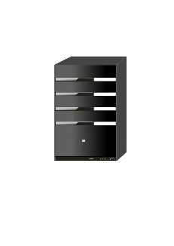


Certificate
X.509 - the most common format for public key certificates
Very general
The format is use case oriented
e.g. Public Key Infrastructure (PKI) X.509 in RFC 5280.
Certificate Authority (CA)
(e_{ca}, d_{ca}), certificate(CommonName_{ca}, e_{ca}) preinstalled everywhere
Alice
(e_{A}, d_{A}), certificate(CommonName_{A}, e_{A})
Server
(e_{s}, d_{s}),
certificate(ip/url, e_{s})
Bob
(e_{B}, d_{B}), certificate(CommonName_{B}, e_{B})

Slide 25
Verifying Certificates
How does Alice (browser) obtain e_{Bob} ?
Browser Alice
Done online
Server
Done offline
CA
choose
(e_{S}, d_{S})
e_{CA}
e_{S} and
proof “I am Server”
check
proof
e_{CA}
issue Certificate signed with d_{CA}
Verify
Certificate
Server
e_{S}
Server e_{S}
e_{CA}, d_{CA}

Slide 26
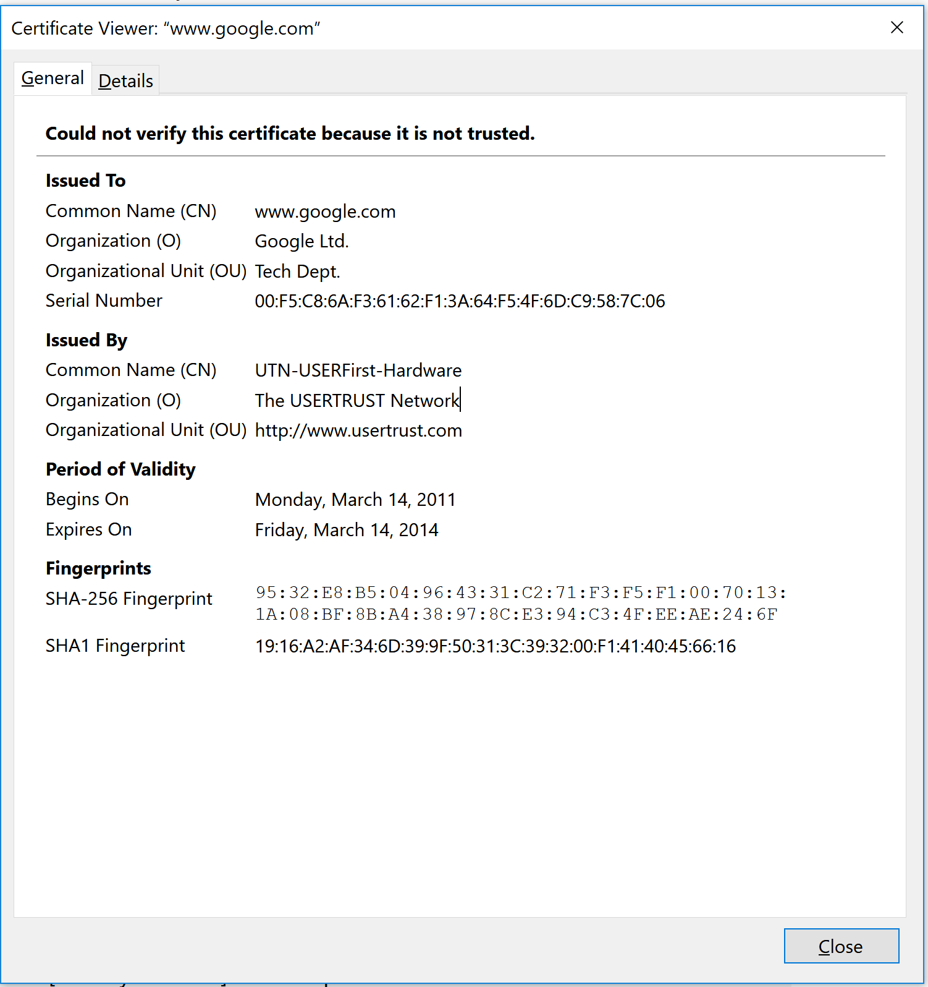
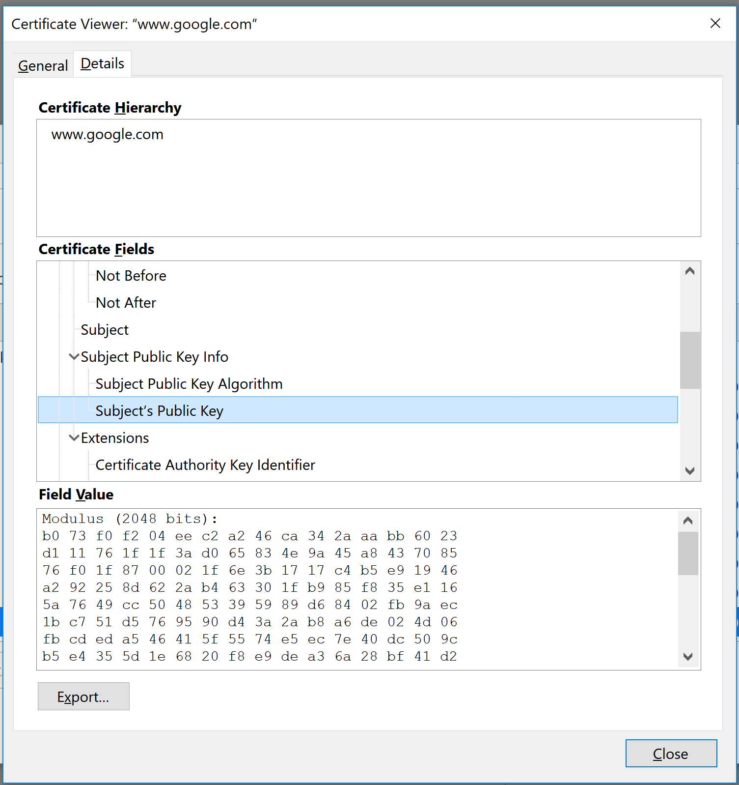
Certificates: example – Firefox/Tools/Options/Privacy&Security/View Certificates
Important fields:

Slide 27
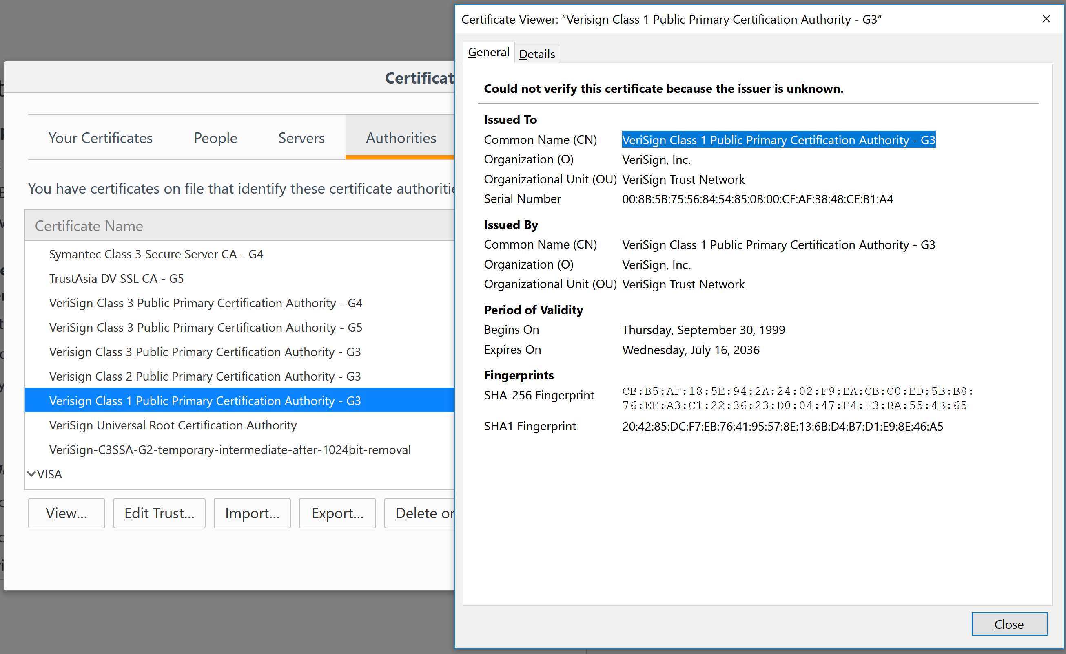
Certificate Authorities

Slide 28
Certificates on the web
The owner of a certificate is called a subject
Common name is the identity of the owner
Subject’s CommonName can be:
An explicit name, e.g. cs.uml, or
A name with a wildcard character, e.g. *.uml.edu or cs*.uml.edu

Slide 29

SSL/TLS Review
Public-key encryption:
Alice
Bob
m
Encryption
c
c
Decryption
m
Internet
e_{Bob}
d_{Bob}
Bob generates (e_{Bob} , d_{Bob} )
Alice uses e_{Bob} to encrypts m and only Bob can decrypt c to get m

Slide 30
Overview of SSL/TLS and HTTPS
(e, d)
Browser
Server
client-hello
server-hello + server-cert (e)
key exchange (several options)
Random k
client-key-exchange: e(k)
Random k
Finished
HTTP data encrypted
Most common: server authentication only

Slide 31
TLS/SSL server certificate [1]
SSL client performs the certification path validation algorithm:
The subject of the certificate matches the hostname to which the client is trying to connect.
The certificate is valid.
The primary hostname (domain name of the website) is listed as the Common Name in the Subject field of the certificate.
Subject Alternative Name (SAN) certificates or Unified Communications Certificates (UCC certificates): a certificate with multiple hostnames (multiple websites) in the field Subject Alternative Name, or in the Subject Common Name backward compatibility.
wildcard certificate - hostnames with an asterisk (*)

Slide 32
TLS/SSL client certificate
Authenticate the client connecting to a TLS service
For access control, for example
Contain an email address or personal name
Rather than a hostname
Supported by many web browsers
Most services use passwords and cookies to authenticate users
Can be used to authenticate devices to ensure that only authorized devices can connect to the server

Slide 33
Outline
http
https
Websockets
MQTT

Slide 34
Issues with HTTP
Half-duplex: request and then response
Half-duplex - each party can communicate with the other but not simultaneously
Full-duplex – tow parties can communicate with each other simultaneously
Too much overhead for real-time communication
Request line, header

Slide 35
WebSocket uses [2]
Social feeds
Multiplayer games
Collaborative editing/coding
Clickstream data
Financial tickers
Sports updates
Multimedia chat
Location-based apps
Online education

Slide 36
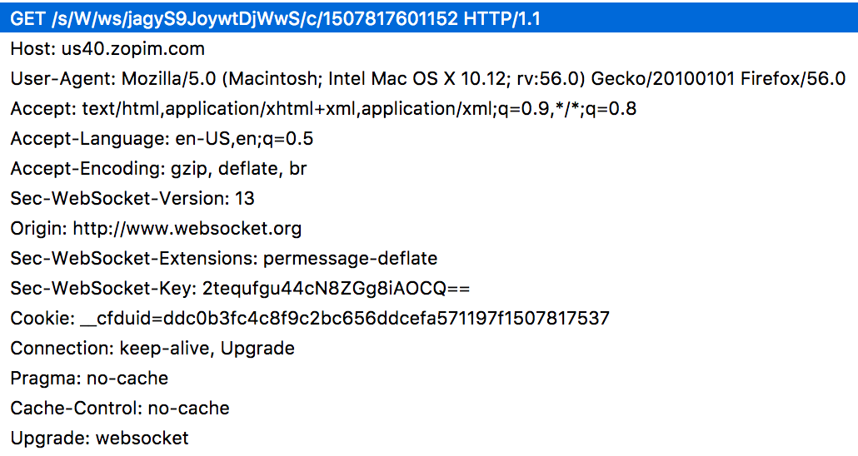
WebSocket protocol – client request
HTTP
Client
HTTP GET Upgrade request
HTTP
Server

Slide 37
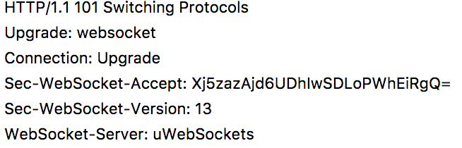
WebSocket protocol – server response
HTTP
Client
HTTP
Server
HTTP 101 Switching Protocol response

Slide 38
Outline
http
https
Websockets
MQTT

Slide 39
MQTT Introduction
MQTT is a messaging broker system
Clients can publish (Pub) messages and subscribe (Sub) to topics.
Clients can both publish and subscribe.
A broker communicates with clients.
Topics can have subtopics.
Topics starting with $ are reserved for special topics
Refer to AWS IoT topics

Slide 40

Messaging Broker System
A messaging broker system uses a publish/subscribe protocol based on a “hub and spoke” model
Hub: server/broker
Spokes: clients
Clients communicate with each other through the hub
Spoke
Spoke
Spoke
Hub
Spoke
Spoke
Notes:
Spoke (from www.m-w.com)
a. any of the small radiating bars inserted in the hub of a wheel to support the rim b. something resembling the spoke of a wheel
2: any of the projecting handles of a boat's steering wheel

Slide 41
Message Brokering Basic Terms
Broker, called “servers” too
Accepts messages from clients
Delivers the messages to any interested clients
Client
Publishes a message to a topic, or
Subscribes to a topic
or both.
Topic: A namespace for messages on the broker
A forward slash / is used to separate the topic hierarchy
Clients do not need to initialize a topic before subscribing and publishing, and the broker will process the request automatically
e.g., myhome/groundfloor/familyroom/humidity

Slide 42
Message Brokering Basic Terms (Cont’d)
Publish: a client sends a message to the broker, using a topic name.
Subscribe: a client notifies the broker the topics of interest
The broker sends messages published to that topic to subscribers
A client can subscribe to multiple topics.
Unsubscribe:
Tell the broker not to send the client the messages to a particular topic any more

Slide 43
Why not just use HTTP?
HTTP is heavy
A lot of fields in the headers.
Needs multiple POST operations to distribute one message to multiple clients while a MQTT broker needs one publish
A message brokering system is light
An MQTT packet can be only 2 bytes.

Slide 44
Representational state transfer (REST) v.s. HTTP
REST-compliant Web services define operations for clients to work on web resources
Roy Fielding defines REST in 2000 in his Ph.D dissertation
Roy Fielding used REST to design HTTP 1.1 and Uniform Resource Identifiers (URI).
RESTful Web service operations through HTTP verbs GET, POST, PUT, DELETE
Note: HTTP was initiated by Tim Berners-Lee

Slide 45
Reference
[1] Public key certificate, Wikipedia, 2017
[2] Jonathan Freeman, 9 killer uses for WebSockets, InfoWorld, Nov 14, 2013

